Slide 1





Requirements & Project Management
Azure Boards
Azure Wiki
Microsoft TFS
Atlassian Jira Software
Atlassian Confluence

Slide 2
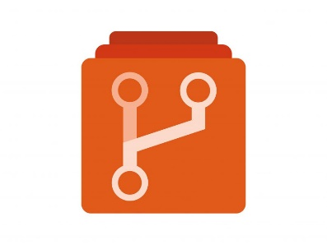


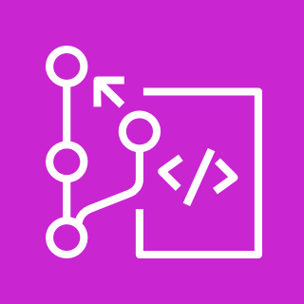


Source Code Management
Azure Repo Git/TFVC
Git
Bitbucket
Github Enterprise
AWS CodeCommit
Gitlab Ultimate

Slide 3



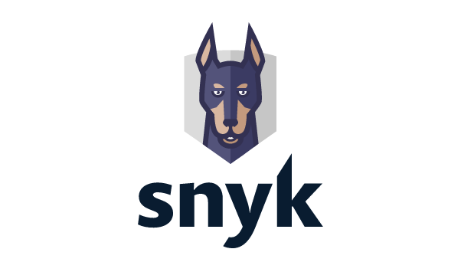


Code Analysis and Code Coverage
SonarQube
SonarCloud
Jacoco
Synk
Trivy
Github Advanced Security

Slide 4

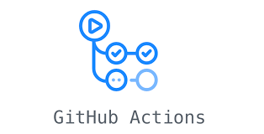



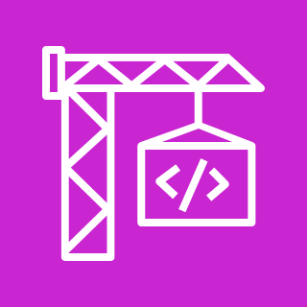
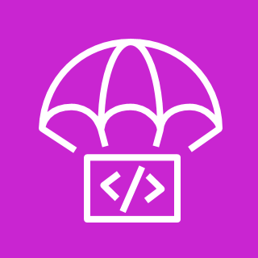





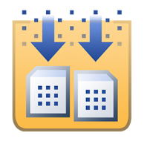





Continuous Integration & Continuous Delivery
Azure Pipelines
Jenkins
GitHub Action Workflow
Gitlab Pipelines
AWS CodePipeline
AWS CodeBuild
AWS CodeDeploy
Bamboo
CicrleCI
BitBucket Pipelines
Ant
Maven
Gradle
MS Build
Jfrog Artifactory
Nexus
Ansible
Flyway

Slide 5
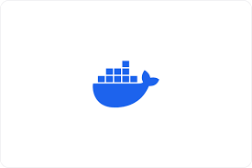





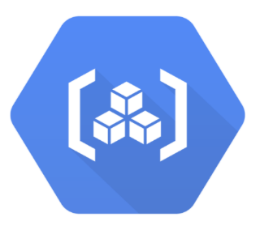




Containerization
Docker
Podman
Kubernetes
AWS ECR
AWS ECS
AWS EKS
Argo CD
Azure Kubernetes Services - AKS
Helm Charts
Google Cloud Run
GKE

Slide 6






Test Management
Azure Test Plans
Microsoft TFS Test Hub
Zephyr Squad
Zephyr Scale
XRAY
Testrail

